Slide 1
Intent Recognition
atjahyanto@gmail.com

Slide 2
Intent Recognition
Turn on the lights
The process of understanding a user's intent from text or speech in a conversation with a system (e.g., a chatbot, voice assistant, or dialogue system).
Example:
User: "What's the weather like today?" → Intent: weather_query
User: "Book a ticket to Jakarta tomorrow morning" → Intent: book_ticket
User: "Hello" → Intent: greeting
intent
entity
Book a ticket to Jakarta tomorrow

Slide 3
Intent and Entity

Slide 4
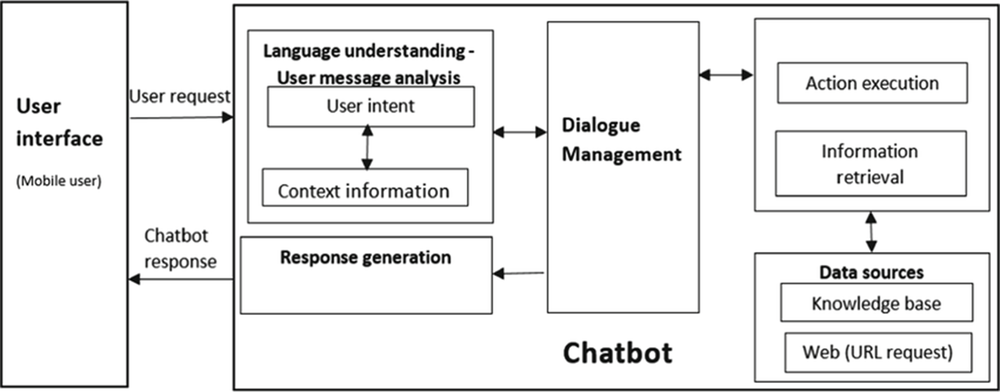
Intent Recognition
Mengidentifikasi tujuan atau intent dari suatu kalimat atau pernyataan pengguna (user utterance).
Komponen inti dalam sistem seperti chatbot, voice assistant, dan sistem tanya-jawab otomatis.
Identifying the purpose or intent of a sentence or user statement (user utterance).
Core components in systems such as chatbots, voice assistants, and automated question-and-answer systems.

Slide 5

Chatbot Architecture
User input: “I want to book a flight.”

Slide 6
Intent Recognition
“I want to book a flight.” → book_flight
“What’s the weather today?” → check_weather
“Book a flight to Jakarta.” → book_flight
“Cancel my ticket.” → cancel_booking
“What’s the status of my order?” → check_order_status

Slide 7
Challenges in Intent Recognition

Slide 8
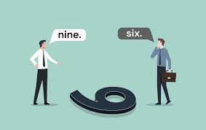
Ambiguous Sentences
Kalimat yang memiliki dua atau lebih interpretasi makna karena struktur, kata, atau konteksnya yang tidak jelas atau bisa dimaknai ganda.
Sulit dipahami secara akurat oleh sistem jika tidak disertai dengan konteks atau penanganan khusus.
Sentences that have two or more interpretations of meaning due to unclear or ambiguous structure, words, or context.
Difficult to be accurately understood by the system without context or special handling.

Slide 9

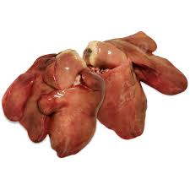


Ambiguous Sentences
Idiomatic Meaning
“Saya makan hati”
Structural Meaning
"Time flies like an arrow“ → syntactic ambiguity
Idiomatic Meaning
"Waktu berlalu dengan cepat.“ → “Time passes quickly”
“Serangga bernama Times seperti anak panah” → The insect named Time is like an arrow
Structural Meaning

Slide 10
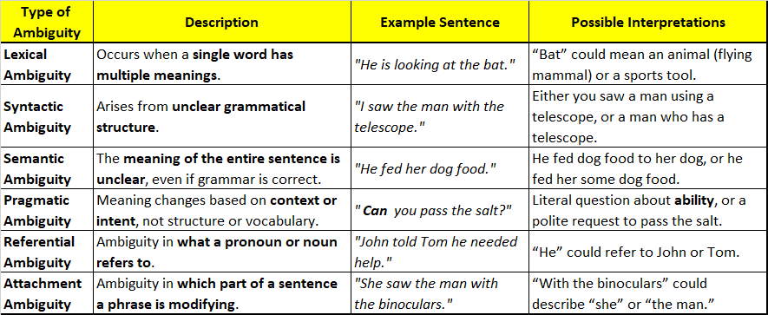
Types of Ambiguity

Slide 12
Complex sentences
Kalimat yang terdiri dari satu induk kalimat (independent clause) dan satu atau lebih anak kalimat (dependent clause).
Anak kalimat ini tidak dapat berdiri sendiri karena maknanya bergantung pada induk kalimat.
A sentence consisting of one main clause (independent clause) and one or more subordinate clauses (dependent clauses).
This subordinate clause cannot stand alone because its meaning depends on the main clause.
She stayed home → main clause
because → conjunction
she was sick → subordinate clause
She stayed home because she was sick.

Slide 13
Challenges in Intent Recognition with Complex Sentences

Slide 14
Challenges in Intent Recognition with Complex Sentences
"I want to book a flight and also check my reservation.“
→ making it difficult to directly map to a single intent.
Breaking sentences into logical units
Determining main and secondary intent
Ignoring non-intentional information (e.g., polite expressions) → “Please, I want to book a flight”
"I want to book a flight”
“I want to check my reservation.“

Slide 16
Non-standard language and typos
Non-standard language: A form of language that does not follow the official rules of grammar, spelling, or standard vocabulary used in formal situations or standard writing. Often found in everyday conversation, social media, chat, or local dialects.
Typo: An unintentional typing or writing error. Typos usually occur due to typing speed, pressing the wrong key, or lack of attention.

Slide 17

Handling the typo: autocorrect library Python
from autocorrect import Speller
spell = Speller(lang='en')
text = "book a fligt"
print (text)
print(spell(text)) # Output: "book a flight"

Slide 18

Handling the typo: autocorrect library Python
kamus-Indonesia.txt
saya
kamu
dia
kita
mereka
pergi
datang
beli
jual
tiket
pesawat
kereta
kamar
hotel
jakarta
bandung
surabaya
besok
hari
ini
pagi
malam
mobil
motor
pesan
batal
ubah
jadwal
konfirmasi
# pip install pyspellchecker
from spellchecker import SpellChecker
spell = SpellChecker(language=None)
spell.word_frequency.load_text_file('kamus-indonesia.txt’)
text = "kmar hotel"
print (text)
hasil = []
for word in text.split():
newword = spell.correction(word)
hasil.append(newword)
print (hasil)
print(' '.join(hasil))

Slide 20
Generalization to New Domain
Kemampuan model untuk tetap mengenali intent secara akurat, meskipun konteks, kosakata, gaya bahasa, dan jenis intent-nya berbeda dari data yang digunakan saat pelatihan (training).
The ability of the model to continue to recognize intent accurately, even if the context, vocabulary, language style, and type of intent are different from the data used during training.
Chatbot for Traveling
Chatbot for Medical
book a doctor’s appointment
book a flight
Text: "I want to book an appointment."

Slide 21
Generalization to New Domain
The model's ability to continue to recognize intent accurately, even if the context, vocabulary, language style, and type of intent are different from the data used during training.

Slide 22
Solution Approach

Slide 24
Ambiguity Handling Strategies
Use previous context (dialog history)
Structural parsing (dependency/constituency parsing)
Disambiguation with pretrained models like BERT
Confirm to the user if confidence is low
if intent_confidence < 0.7:
return "Could you please clarify what you mean?"
else:
return f"Intent recognized: {predicted_intent}"

